Slide 1

Feature-Based Reinforcement Learning for the Rubik Cube
Team Members:
Mohammed Abbas (00717674)
Mudassir Mohammed (00712876)

Slide 2
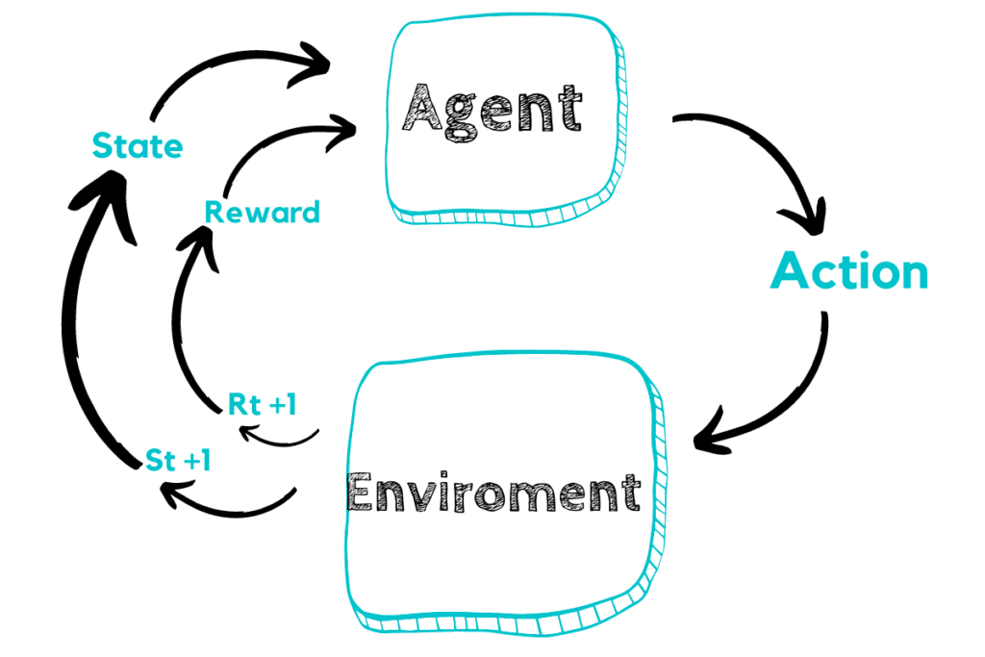
Statement of project
Create and train a reinforcement learning agent that learns to solve a 3x3x3 size Rubik cube using feature-based state representations.

Slide 3
Approach
For solving the problem of Rubik’s cube, we planned to design a feature-based Q-Learning, which utilizes a pattern database as well as is a powerful reinforcement learning technique, to quantify the quality of near-finished cubes
This project makes the assumption that a Rubik’s cube can only execute side turns of 90 degrees and 180 degrees, which helps in reducing the branching factor of the cube’s state space tree

Slide 4
Deliverables
The project also attempts to reach a solution for a solved cube which has had n random moves executed on it, this value n currently can be up to 5 to find a goal state for each execution, or in the range of 6-10 to be somewhat successful
The project attempts to achieve a solution for by solving a cube to its final state which is being solved. It takes n random moves to be executed on it which initially would be set to 5, which helps in finding a goal state for each execution, or in the range of 6-10 to be somewhat successful

Slide 5
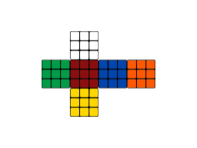
Evaluation methodology
We plan to include variety of test cases which upon execution would confirm the correct implementation of the cube’s state representation.
Also, we plan to have the final state output of the execution to be the state of all six faces of the Rubik’s cube, the correct output should be representing each color of the six sides of the cube solved.

Slide 6
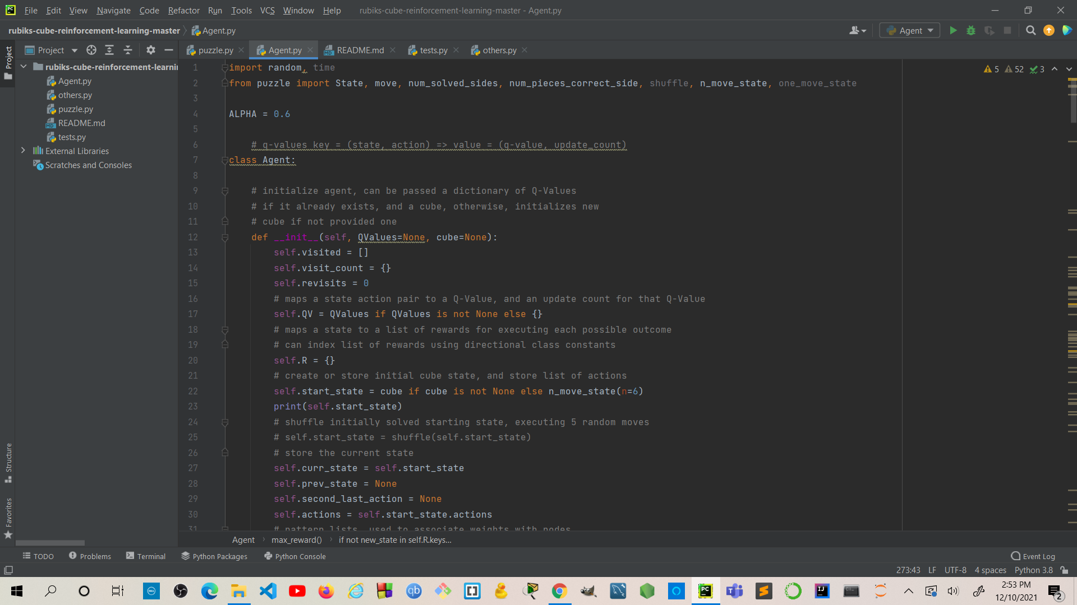
Code snippets and Output

Slide 7
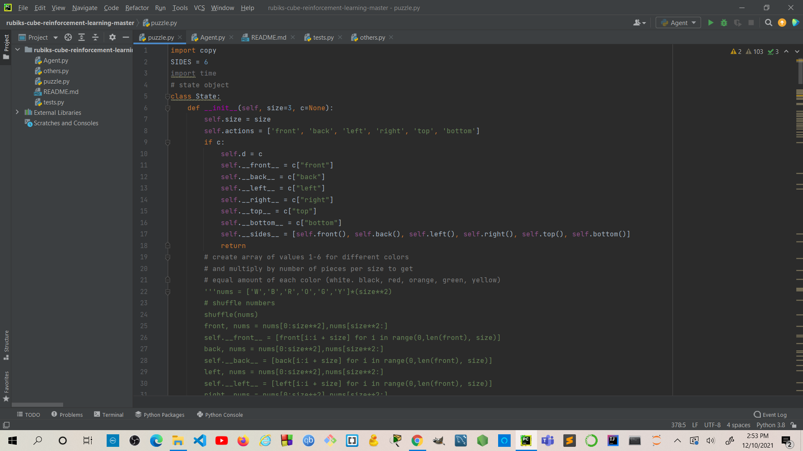
Code snippets and Output

Slide 8
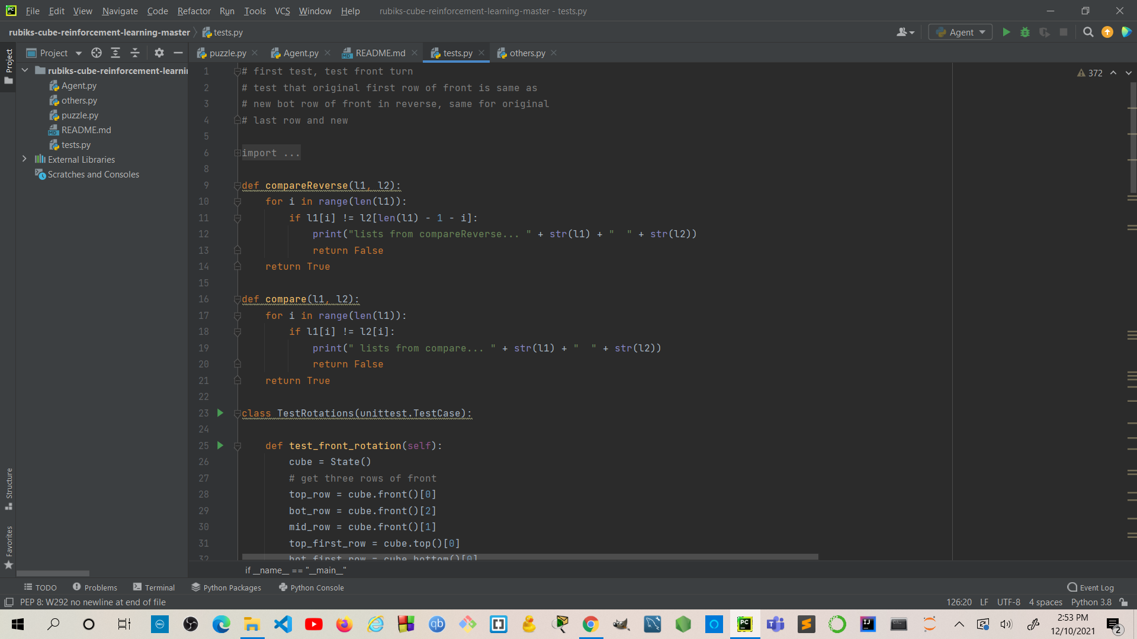
Code snippets and Output

Slide 9
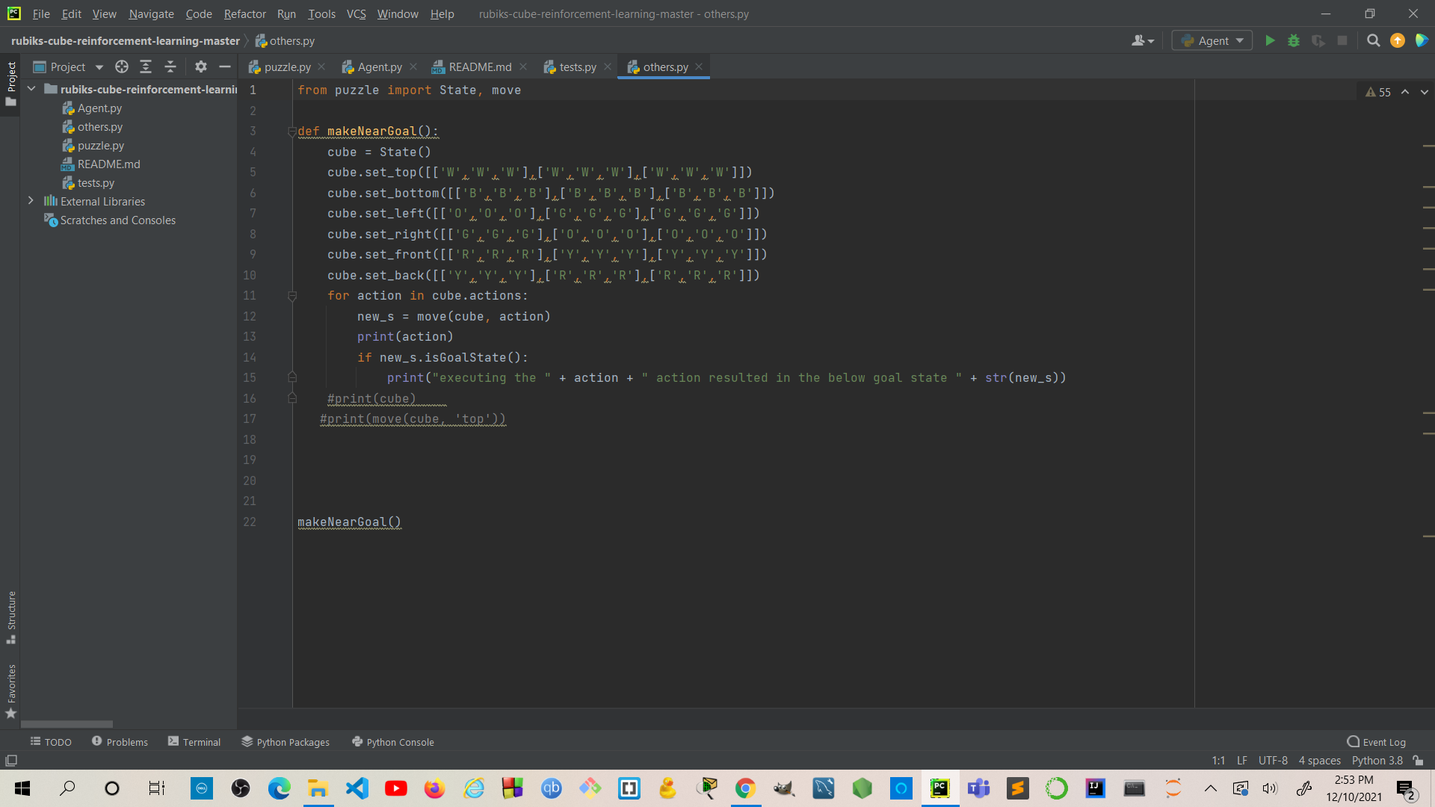
Code snippets and Output

Slide 10
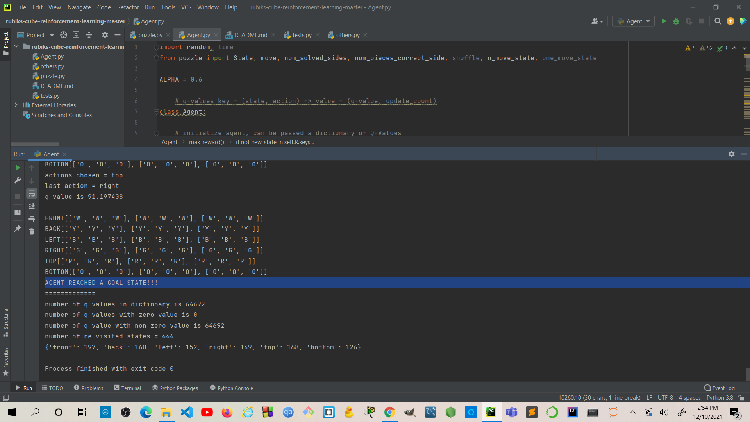
Code snippets and Output

Slide 11


